Slide 1

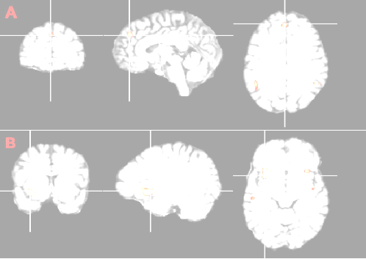
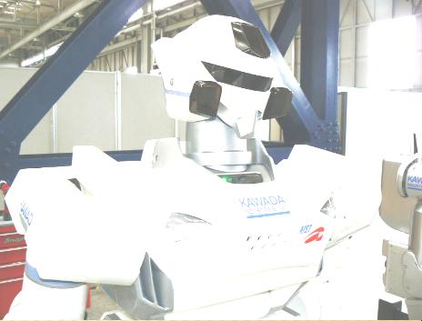


Group 6 presents
The capacity for self determined choice.
10 Minute Presentation

Slide 2



Freedom is pure observation without direction, without fear of punishment and reward.
-Krishnamurti(1929)
Do humans have free will?
Arguments that argue: YES
Arguments that argue: NO
Compatibilism
Libertarianism
Quantum Mechanics
Buddhism
Theological Determinism
The law of causality
Freudianism
Conditioning & Behaviorism

Slide 3



Slide 4

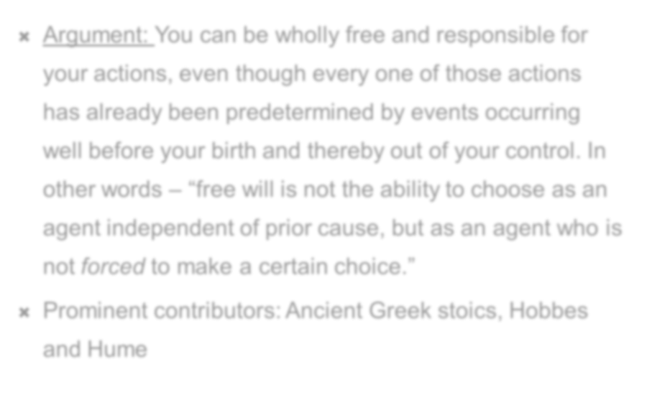
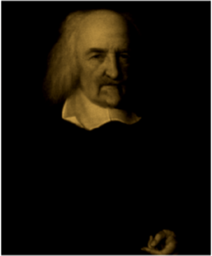
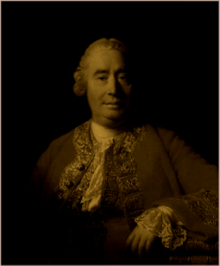
Argument: You can be wholly free and responsible for your actions, even though every one of those actions has already been predetermined by events occurring well before your birth and thereby out of your control. In other words – “free will is not the ability to choose as an agent independent of prior cause, but as an agent who is not forced to make a certain choice.”
Prominent contributors: Ancient Greek stoics, Hobbes and Hume
Source: http://en.wikipedia.org/wiki/Compatibilism

Slide 5

Argument: At this moment one could ether continue reading this article if wanted, or stop. Under this assertion , being that one could do either, the fact of how the history of the world will continue to unfold is not currently determined one way or the other.
If our character is formed indeterministically, then our actions can still flow from our character, and yet still be incompatibilistically free.
Although the mind is in fact part of the physical world, it involves a different level of description of the same facts, so that although there are deterministic laws under the physical description, there are no such laws under the mental description, and thus our actions are free and not determined.

Slide 6

Argument: According to physicists, quantum mechanics predicts events only in terms of probabilities, casting doubt whether the universe is deterministic at all. The possibility that the universe at the macroscopic level may be governed by indetrministic laws as it is generally accepted to be at the quantum level, shows evidence of free will.

Slide 7

Buddhism accepts both freedom and determinism.
The Buddha said: “There is free action, there is retribution, but I see no agent that passes from one set of momentary elements into another one, except the connection of those elements.”
Buddhism believes in neither absolute free will no absolute determinism.
The idea of absolute freedom is foolish, because it denies the reality of one’s physical needs and circumstances. Equally incorrect is the idea that we have no choice in life or that our lives are predetermined.

Slide 8

Arguments against Free Will

Slide 9

Argument: “God predestined the course of the universe in exhaustive detail, and the world is unfolding according to a plan which God determined prior to creation. God's exhaustive control over the universe precludes the possibility of any of its events being otherwise. Given God's will, no events in the universe could have happened differently, and no future events will happen contrary to God's will. In addition, ‘determined system' or ‘determined universe' means the sum total of all the events which God has determined. “ In other words- god set a path for the world to follow and cannot stray of that past because, man cannot escape gods plan.
Source: http://ethicscenter.nd.edu/publications/vita1todd.shtml

Slide 10

You see there is only one constant. One universal. It is the only real truth. Causality. Action, reaction. Cause and effect.
-The Matrix Reloaded (2003)
Argument: The law of causality proposes that for every action there
Is a preceding reaction. Therefore, it can be said that an individual is
not making choices based on self-based determinism, because the
law of causality forces the individual to act in a way that the individual
does not necessarily want to act. In other words choice is an illusion,
we do things because of causes not choices.
Example: An individual goes to college to get an education.
-Cause: There is some factor causing the individual to go to
College (Can vary from job training to pressure from others, etc.).
-Effect: The individual goes to college due to the cause.

Slide 11

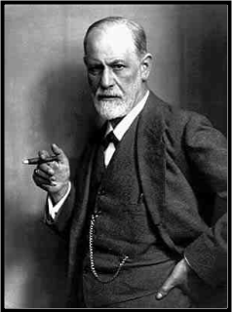
A man should not strive to eliminate his complexes but to get into accord with them: they are legitimately what directs his conduct in the world.
- Source: http://www.brainyquote.com/quotes/authors/s/sigmund_freud.html
Argument: Every individual has an Id, ego, and supper- ego. This system of forces together subconsciously determine how an individual behaves.
Id: The id is libido energy or sexual energy. Basically, the id is the drive of the system.
Supper-ego: The supper-ego contains societally imposed standards such as ‘good’ and ‘bad’.
Ego: The ego is an individuals sense of self, and acts as a moderator between the id and the supper-ego. Also the ego defends itself with defense mechanisms such as repression.
http://en.wikipedia.org/wiki/Defense_mechanisms

Slide 12

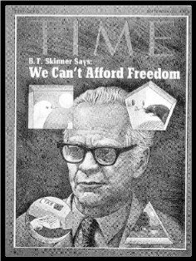
Give me a child and I'll shape him into anything.
-B.F Skinner
Argument: Any individual can be conditioned to exhibit certain behaviors trough two types of conditioning- operant, and classical conditioning. Also, this argument states that we are conditioned by society to exhibit these behaviors. Therefore humans do not have freewill, because human behavior is based on conditioning not will.
Operant conditioning: This type of conditioning is similar to law & punishment. If the individual is good they get reinforcement by not having negative punishment (prison) forced upon them.
Classical conditioning: This type of stimulus can be seen in the famous case of Pavlov and his salivating dogs. Where he trained a dog so that every time he rang a bell the dogs mouth would water.
Unconditioned Stimulus- The food
Conditioned Stimulus- The bell
Unconditioned Response- Salivating because of the food.
Conditioned Response- Salivating because of the bell. (US + CS = CR)

